Slide 1
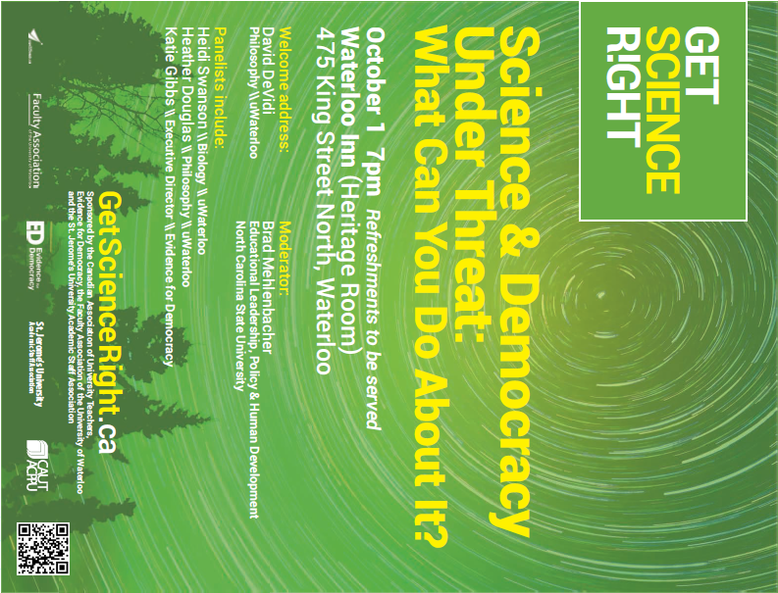

Slide 2
SCIENCE AND DEMOCRACY UNDER THREAT:
WHAT CAN YOU DO ABOUT IT?
Research and public science are under attack in Canada through government policies designed to muzzle scientists, deplete funding and, in turn, deprive Canadians of vital information.
A strong democracy is based on leaders making smart decisions, informed by the best available evidence. A panel of experts wants to discuss with you what we can do about this attack on our very way of life.
Free shuttle bus to the event on Thursday, October 1st leaves Laurier at 6:30 (Aird Overpass) and leaves Waterloo Inn at 8:45.
More information at: eventbrite.ca/e/science-and-democracy-under-threat-what-can-you-do-about-it-tickets-18766295495

