Slide 1
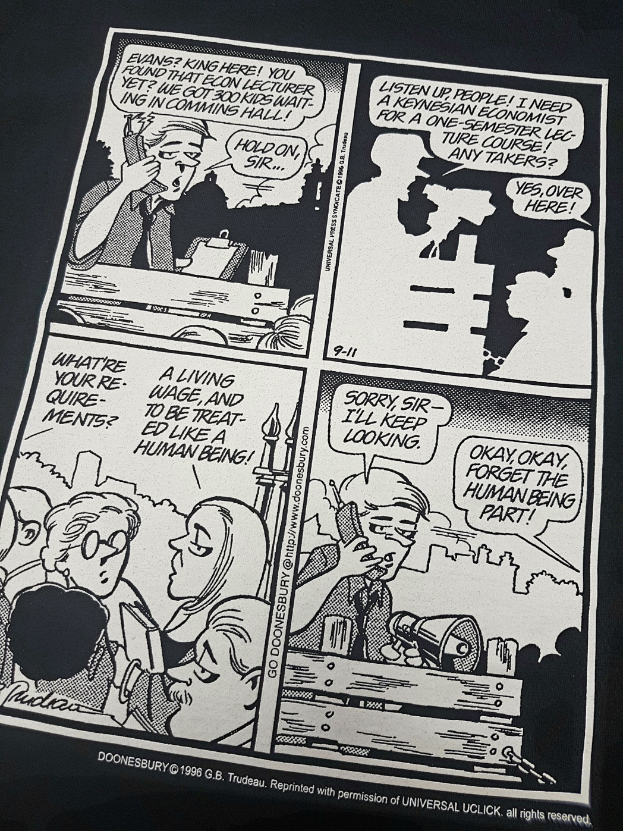
Contract Faculty at Laurier
Teach approximately 50% of students
Hired per course, 4 month contracts
Over 40% at WLU for at least 5 years
No dental or health benefits … even students have these!
Average income of $20,034
Have taught over a quarter million WLU students

