Slide 1


Merit: the basics
“outstanding or superior performance” in one or two areas
  E.g. scholarship and teaching
$1200 added to your reference salary
  Notified by August 31: Merit Increments will be included in recipients’ Reference Salary retroactive to July 1
What do you need to know about Merit?
Notes:
annual merit pool = $126,000
Allocated throughout university based on the proportion of eligible Members per unit

Slide 2
What you need to know about Merit:
1. When you are assessed
2. Information you provide: Annual Report
3. Who assesses you
4. Merit Procedures: assessing Scholarship, Teaching and Service

Slide 3

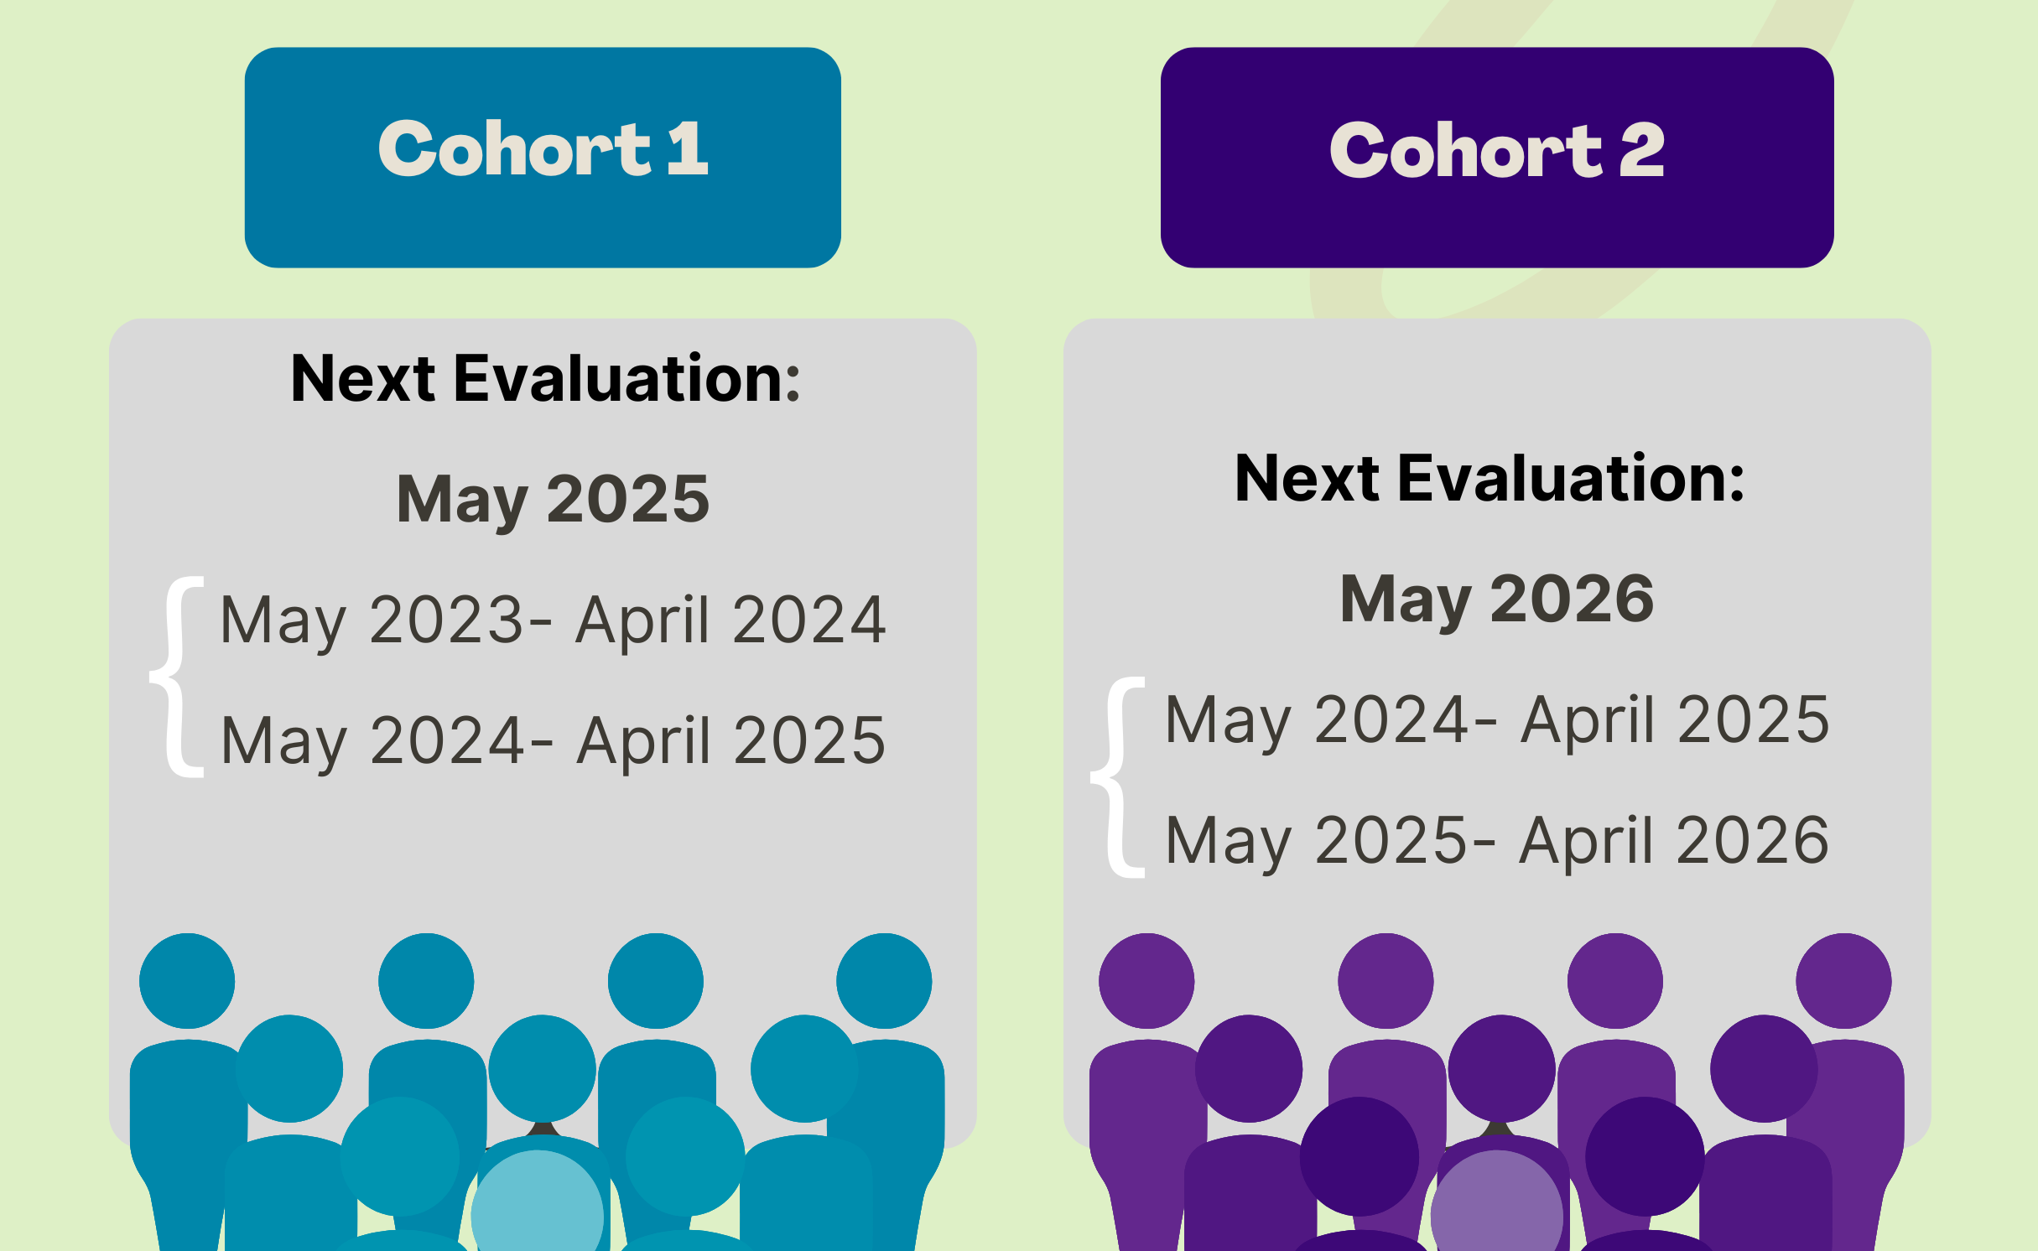
1. When you are assessed:

Slide 4




2. Info you provide: Annual Report
Merit Committee ONLY sees two Annual Reports (no teaching evals, sabbatical report, CV, etc.)
Don’t paste your CV or other materials – committee can only consider your two annual reports from the past 2 years
You can provide an optional 250-word statement
Optional: tell the committee how you are outstanding; draw their attention to identify a merit category (or two)
Submit by May 5th:
Being late may mean you’re ineligible for merit

Slide 5

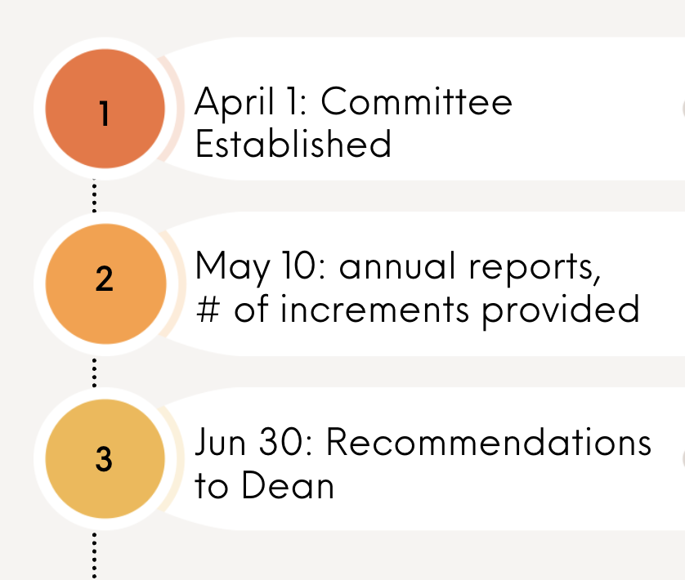
3. Who Assesses You: Merit Review Committee
No fewer than 3,
No more than 7 members
Includes an Equity Representative
Drawn from cohort NOT being considered for merit
No more than one person per academic sub-unit, e.g. can’t have two geographers
For Faculty of Ed & Lazaridis school:
see Appendix H, points 7 & 8 for details

Slide 6

4. Merit Procedures
Committee sets its own procedures, e.g. distribution across 3 performance categories:
Scholarship = 30-50%
Teaching = 30-50%
Service = 10-30%
Must be satisfactory in all 3 areas to be recommended for merit
Unit-specific criteria, including Dept. Tenure/ Promotion Guidelines
Awards/funding/ publication dates must fall within the 24-month period under review
See Appendix H for more details

Slide 7
4. Merit Procedures: Scholarship and Service
Scholarship
Service
publications
invited talks and presentations
contributions to papers and conferences
…
review activities (internal and external)
research reports completed
other research and scholarly activities (e.g., journal editorship)
contributions to the Member’s Department or Faculty
contributions to the Senate, Board, Association and other University activities
contributions to the Member's academic profession
contributions to the Member's community, in the Member’s area of disciplinary expertise
workshops and courses attended
Article 18.5.4

Slide 8

4. Merit Procedures: Assessing Teaching
Teaching (18.5.4)
Note: Committees assign 30-50% of merit increments for outstanding teaching
Other than a teaching award, how to identify outstanding teaching?
regular teaching load
courses (labs/tutorials) taught and mode
supervision
Indigenous forms of teaching
new course or program development
teaching initiatives
workshops and courses attended

Slide 9
Moving Forward: thinking about Merit
Keep track of when you are up for consideration
Highlight outstanding or superior achievements in your Annual Report
Submit on time!
Tips:
Consult with your Chair, mentors about discipline-specific criteria
Teaching and Learning: resource for thinking about teaching/pedagogy – email:
wluteaching@wlu.ca

